Slide 1
Maximum Power Point Tracking for Photovoltaic Systems Using Fuzzy Logic and Artificial Neural Networks
Mentor: Dr. Sushil Chauhan
Major Project 1
Team Members
Raghav Singh (182003)
Kaustubh Bhatt (182012)
Anubhav Sharma (182077)

Slide 2
Contents
Overview
PV System
MPPT using Artificial Neural Networks
MPPT using Fuzzy Logic Controller

Slide 3
Overview
Photovoltaic (PV) panels, that are used to extract electric energy from the sun, have maximum operating point which varies with the environmental conditions, such as solar radiation and temperature. The maximum operating point of a PV panel is the point where the maximum possible power is being extracted from the sun. To be able to efficiently use solar energy as a power source, it is essential to make the PV panel work at its Maximum Power Point (MPP).
To achieve that, a power controller is needed to implement one of the Maximum Power Point Tracking (MPPT) algorithms. PV panels have nonlinear Current-Voltage (I-V) characteristics, and they are affected by the surrounding environmental changes such as solar radiation and temperature.

Slide 4
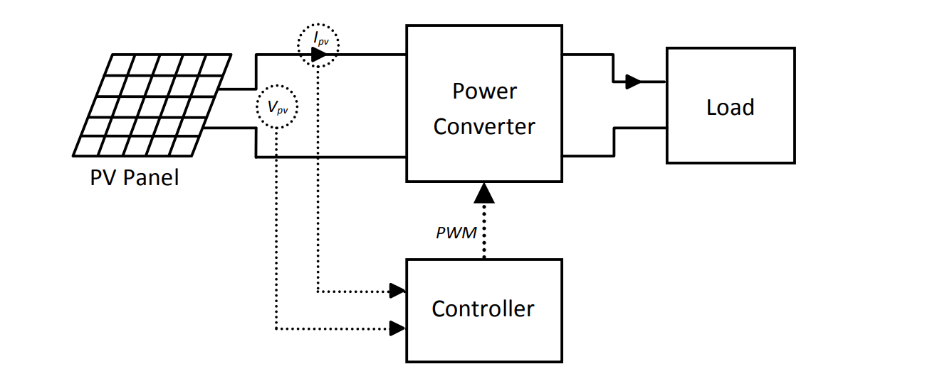
PV System
The model considered is
The model comprises of the following components
PV Panel Model
Power Converter
Controller
Load

Slide 5
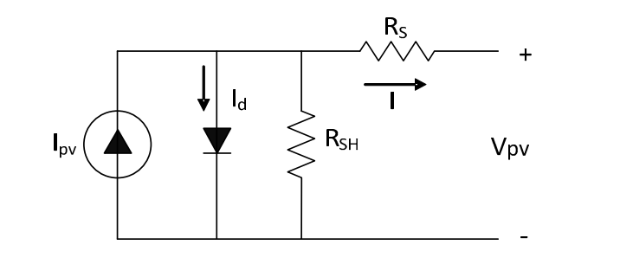
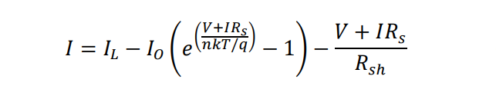
Solar cell can be represented as a current source. The equivalent circuit of a typical solar cell is
The I-V characteristics of a PV cell can be described as

Slide 6

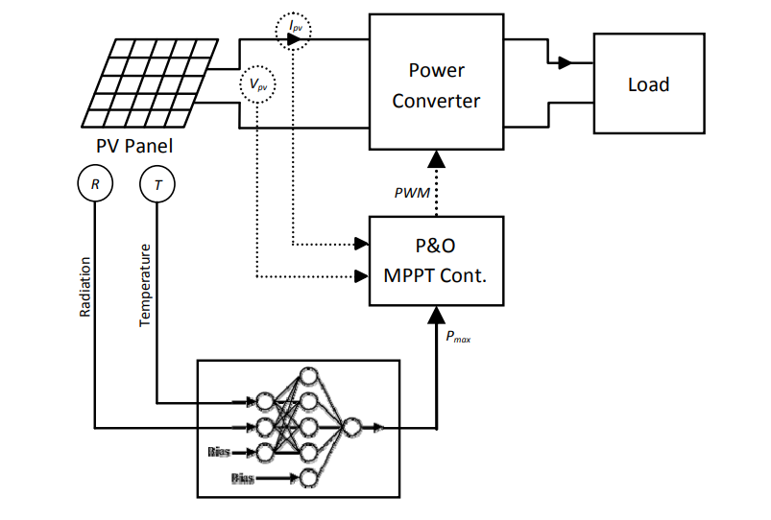
MPPT using Artificial Neural Networks
An Artificial Neural Network (ANN) is designed to estimate the maximum power generation under variable environmental conditions. The neural network is used with an MPPT controller that applies the P&O tracking strategy. The knowledge of MPP can help the controller achieve a faster and more stable tracking of the optimal power point.
The design of the neural network and the controller are

Slide 7

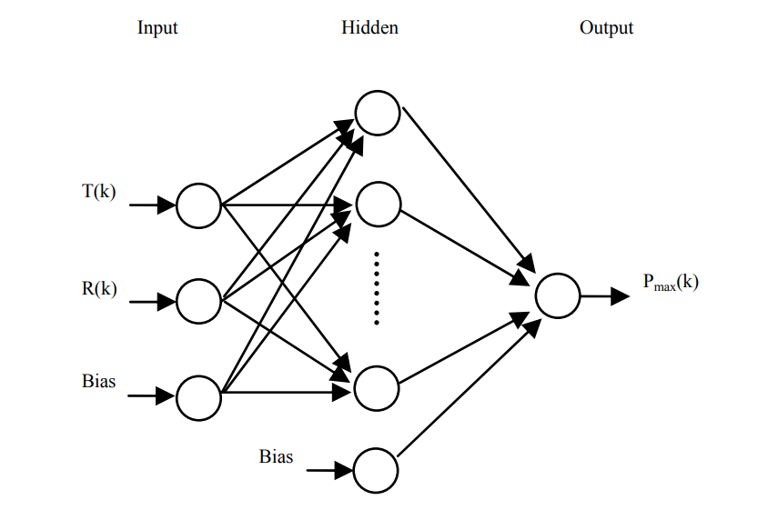
Configuration of Neural Network
The network is a feed forward neural network that consists of three layers; input, hidden, and output layer. The inputs to the neural network are the sun radiation and ambient temperature in addition to a bias signal of 1.0.

Slide 8


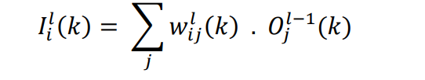
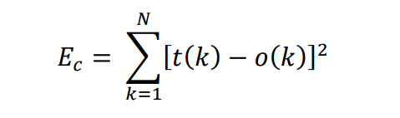
The output of each node in the hidden or output layers can be expressed as
The input I_{i}^{l}(k) represents the weighted sum from the previous layer nodes, and is expressed as
The Back Propagation Learning (BPL) algorithm is used to train the neural network.

Slide 9
Controller Algorithm
The power is first computed based on the measured voltage and current at the output of the PV panel. After that, the calculated power value is compared with the neural network estimation of the maximum power under the present environmental conditions and an error value is produced. If the error is within the permissible range, then the PV panel is working at its MPP, and load is receiving the maximum power. However, if error exceeds the limit, the P&O MPPT strategy is then applied to track the optimum operating point. P&O changes the duty cycle of the PWM signal in fixed steps and keep observing the output power till the MPP is reached. Whenever the error value is below the limit, the P&O strategy is not applied any more. Any change in environmental factors is going to affect both calculated and estimated powers which will cause the error signal to exceed the permissible limit, and thus P&O will be applied again.

Slide 10
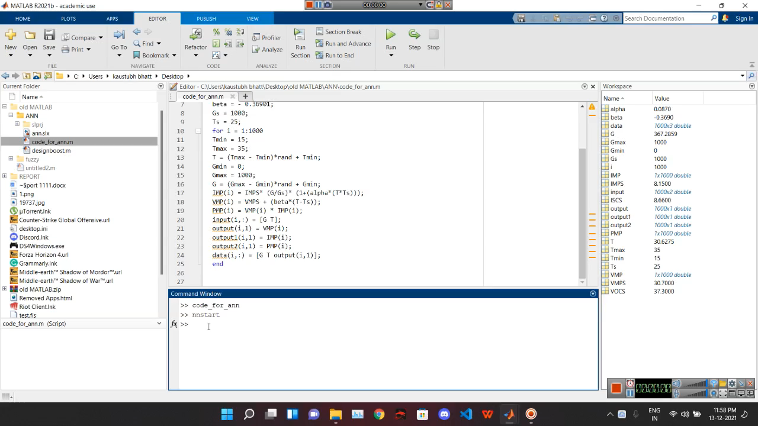

Slide 11
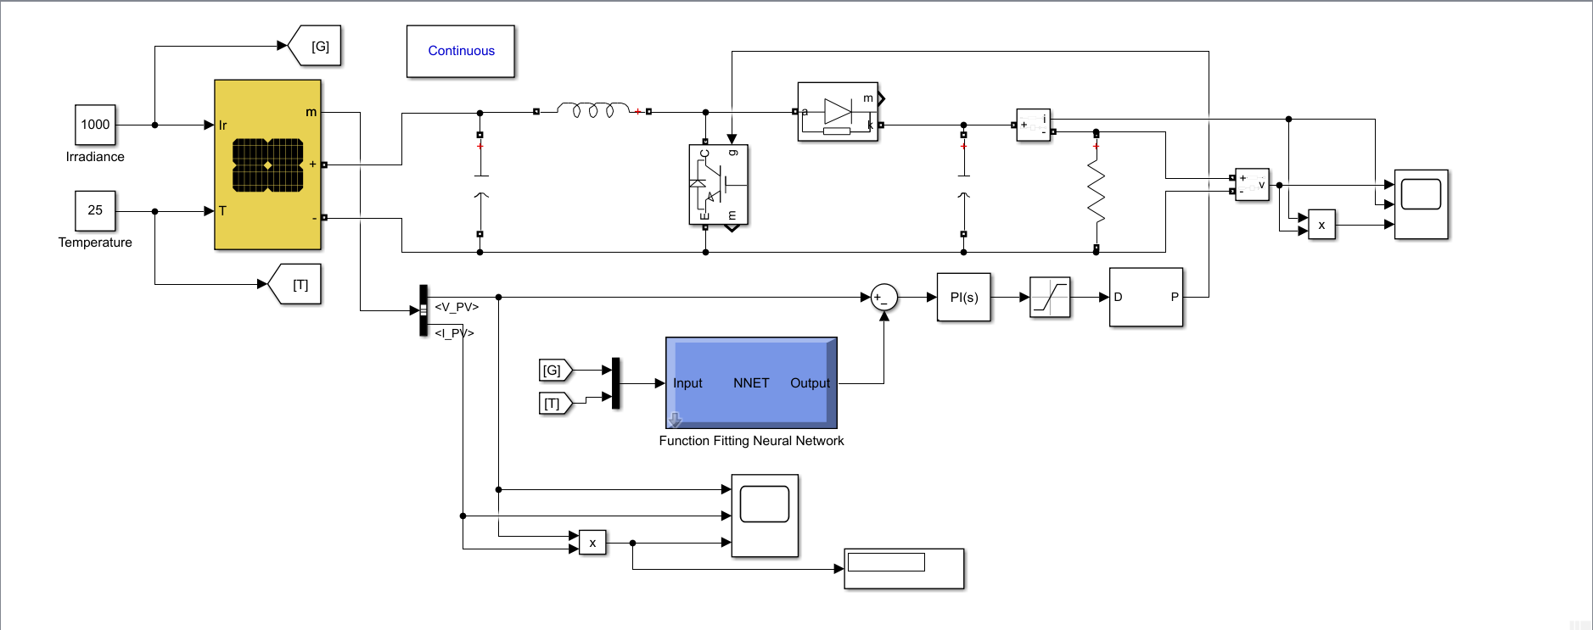
Simulink Model

Slide 12
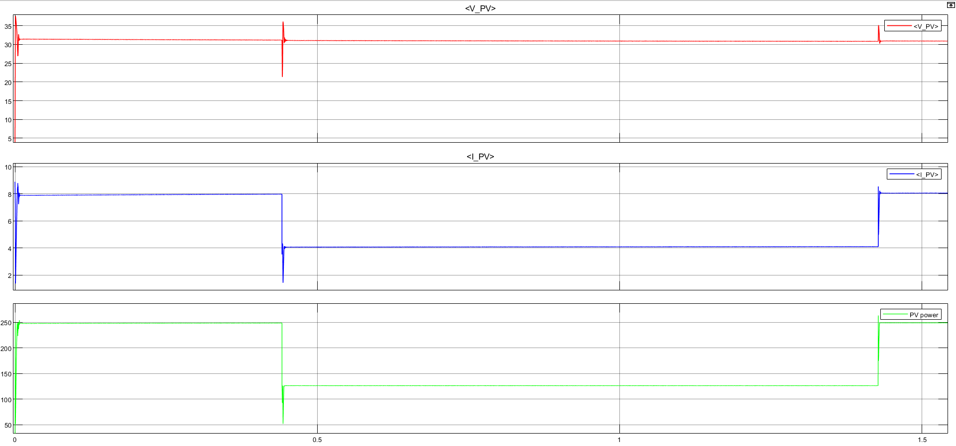
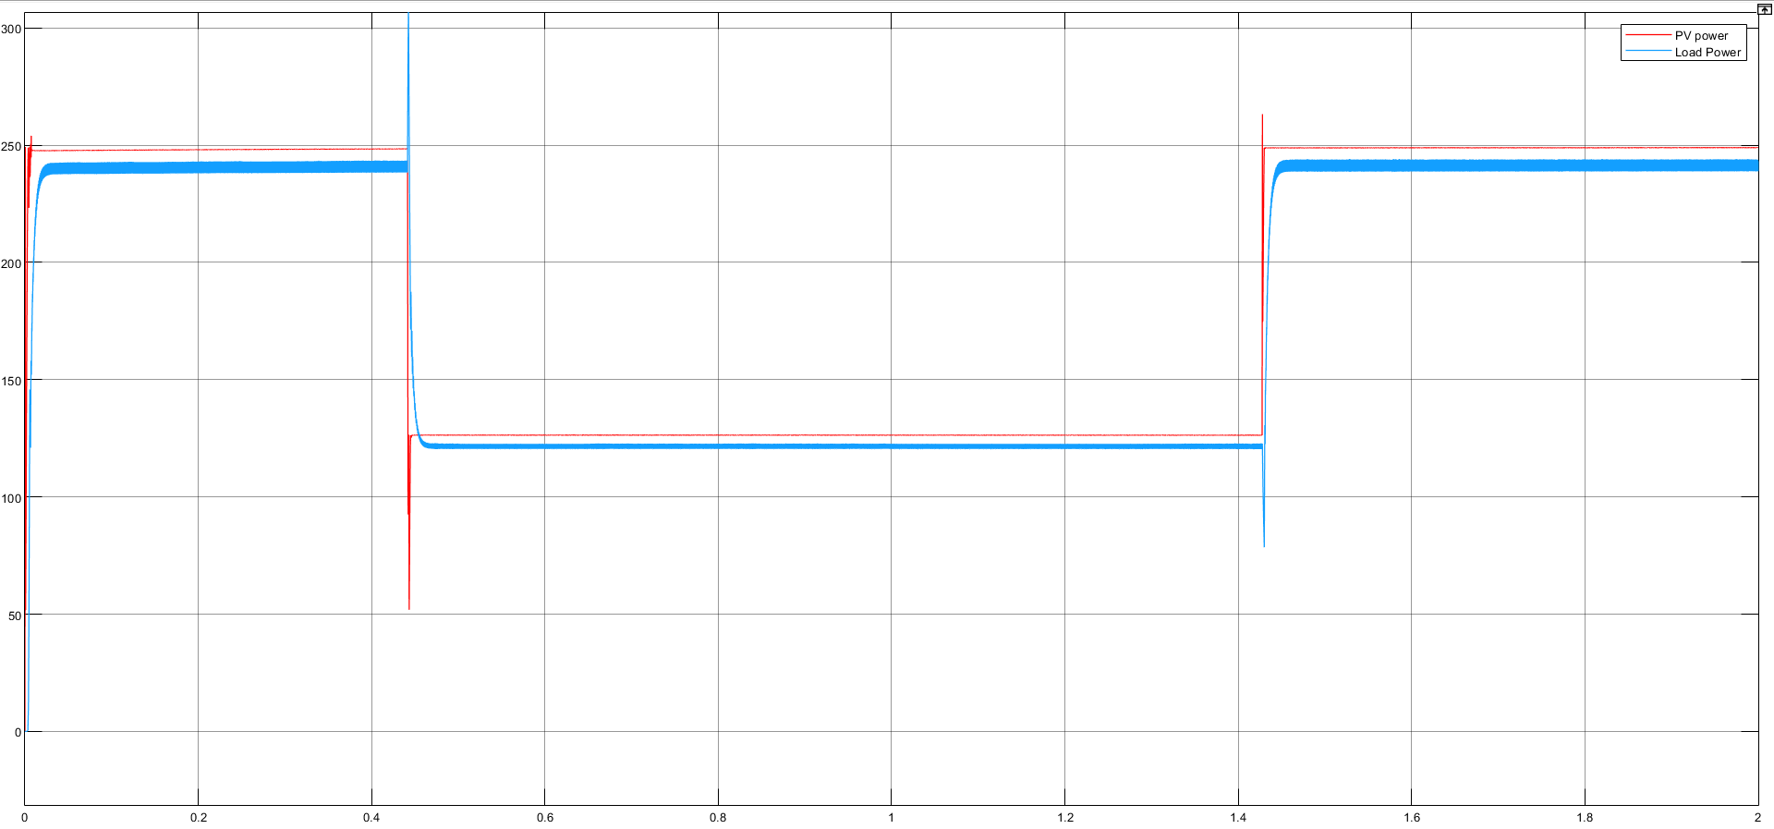
Results

Slide 13
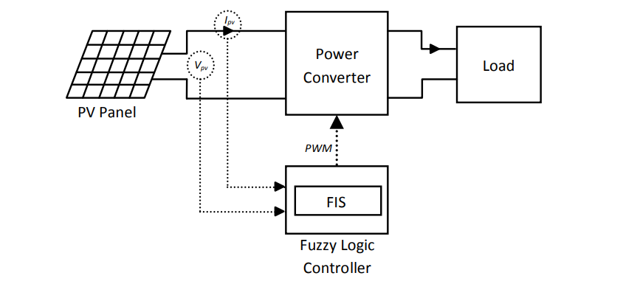
MPPT using Fuzzy Logic Controller
A Fuzzy Logic Controller (FLC) is designed to work as an MPPT controller that tracks the optimal operating point of a PV panel.
Fig. below shows the PV system with the FLC.

Slide 14
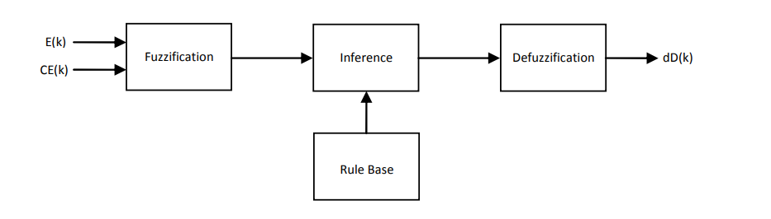


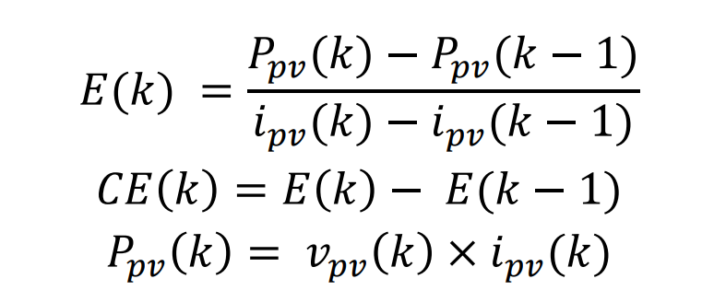
The FLC contains a Fuzzy Inference System (FIS)
The FIS inputs, error (E) and change in error (CE), are obtained using the following equations:

Slide 15
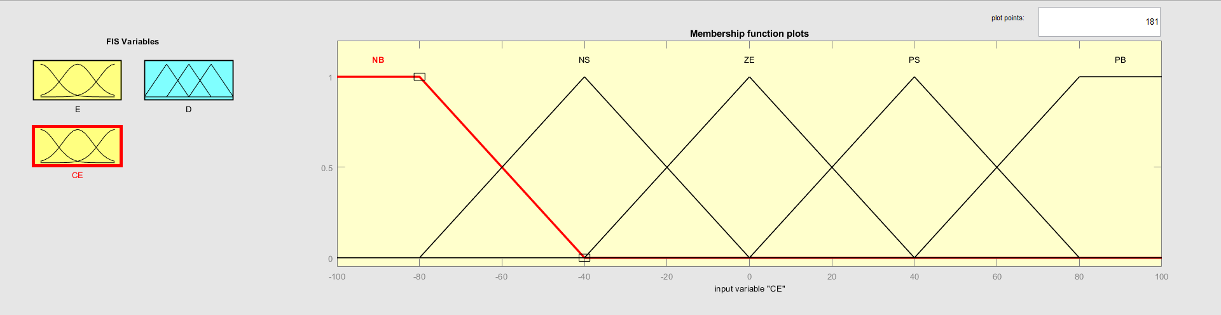
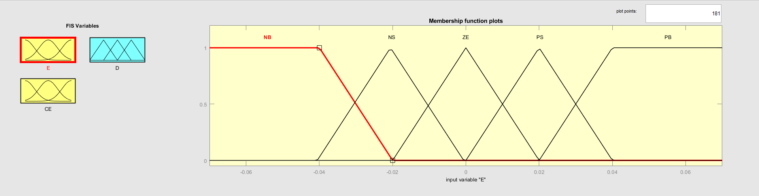
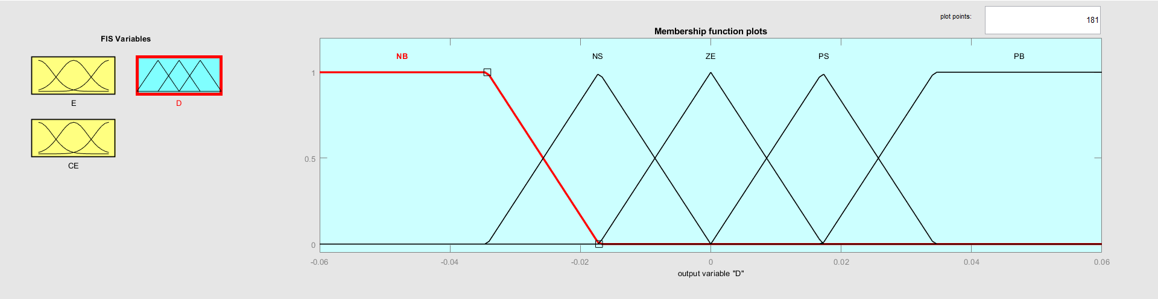
Fuzzification
The input and output variables are expressed in terms of linguistic labels using triangular membership functions. Five different fuzzy subsets were created as following: NB: Negative Big, NS: Negative Small, ZO: Zero, PS: Positive Small, PB: Positive Big. Fig. shows the membership functions of the fuzzy subsets for the system inputs and output.

Slide 16
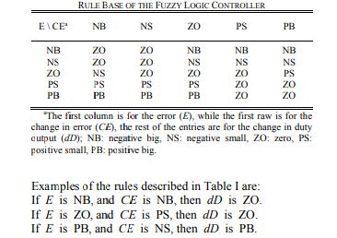
Inference Method
The Mamdani fuzzy inference method with Max-Min operation fuzzy combination law is used. Several composition methods were introduced in the literature, but the commonly used one is the Max-Min. Min operator is used to determine the output of each rule, while Max operator is used to determine the combined fuzzy output. Table shows the rule base of the fuzzy logic controller.

Slide 17
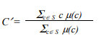
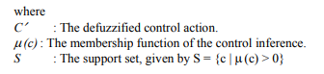
Defuzzification
The system output is a fuzzy set; however, it is usually required to get a nonfuzzy value of control that can be used in the plant. Several methods were described in the literature such as the centroid, the mean of maximum (MOM), first of maxima (FOM), and last of maxima (LOM). The centroid method is widely used in the design of FLCs . It is a more complete representation since the size and shape of the membership function affect the defuzzified value. The centroid method of defuzzification is expressed as

Slide 18
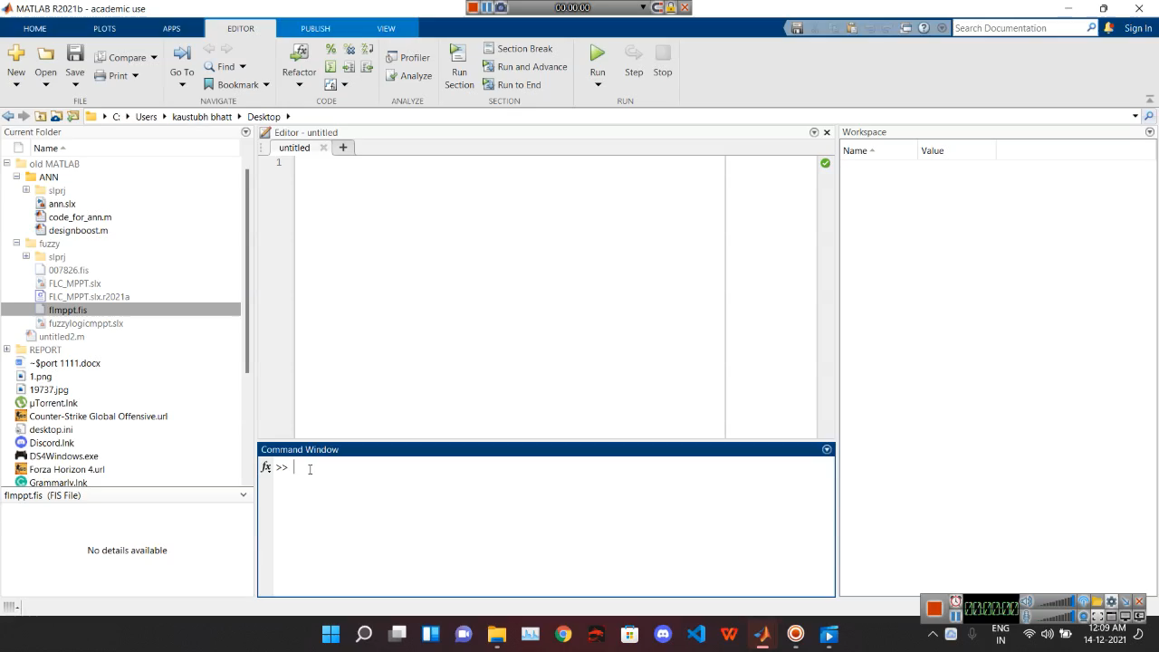

Slide 19
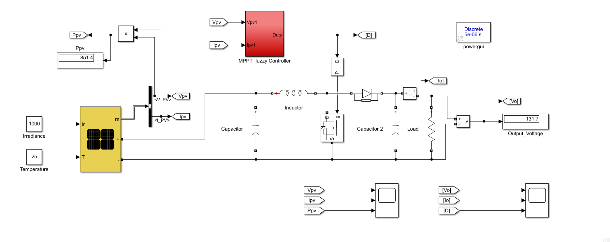
Simulink Model

Slide 20
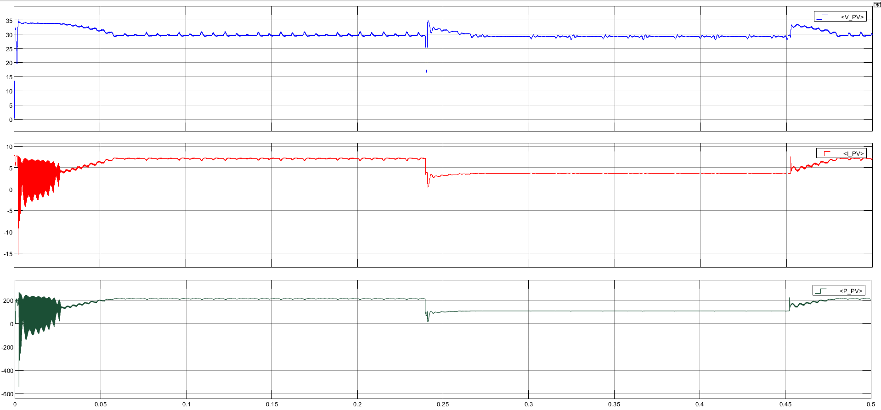
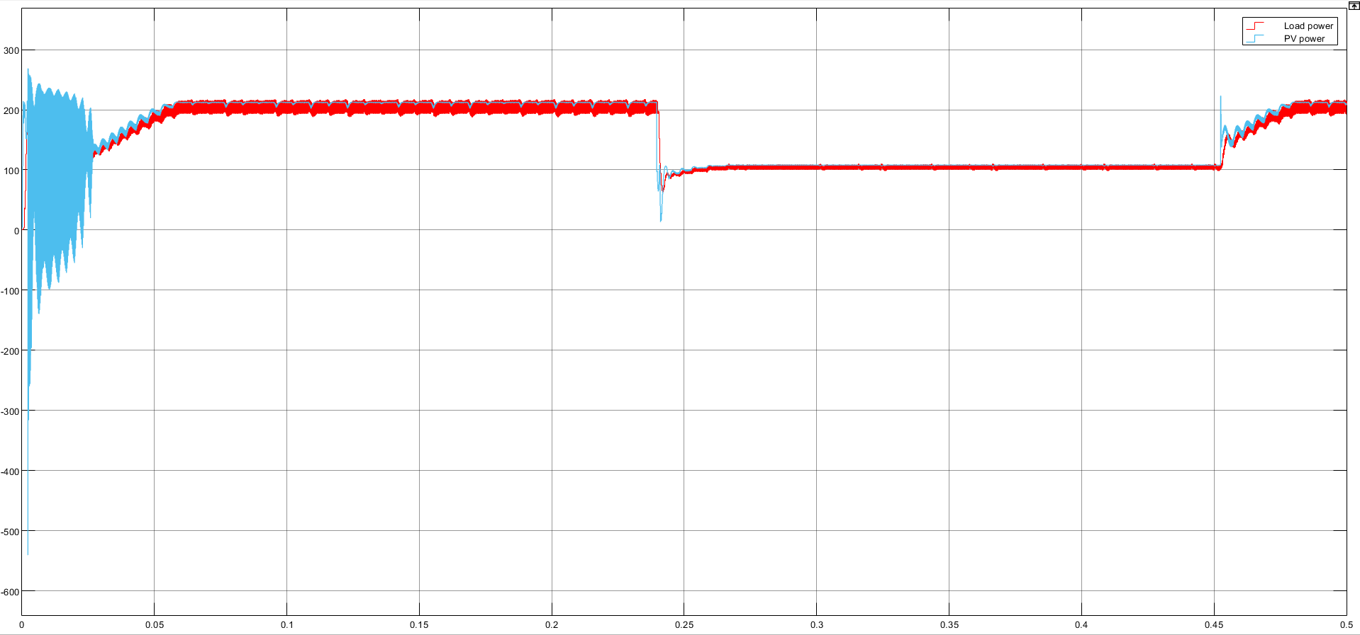
Results

Slide 21
Thank you!

